Slide 1
Engaging Students in a Large Class

Slide 2
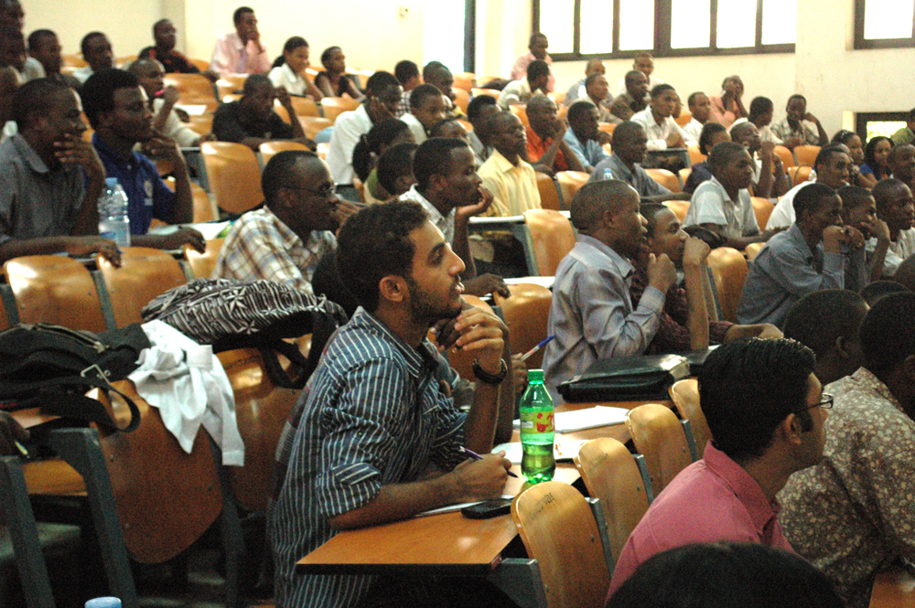

Slide 3
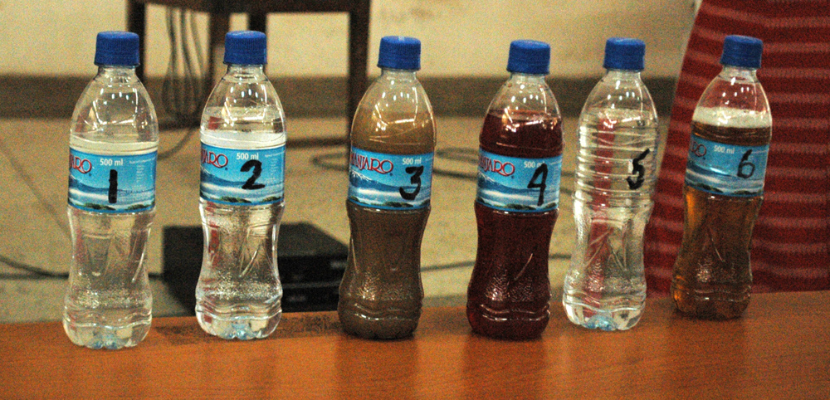

Slide 4
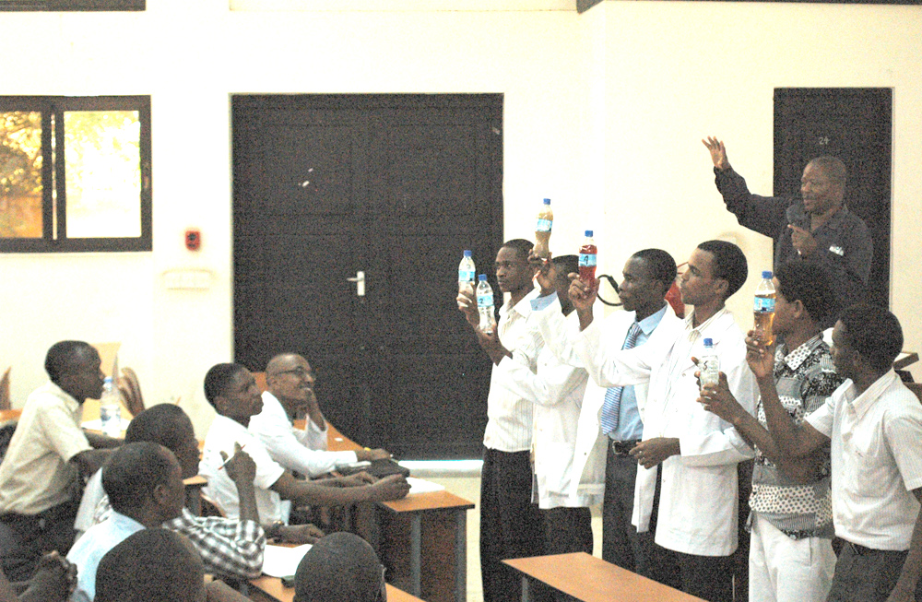

Slide 5
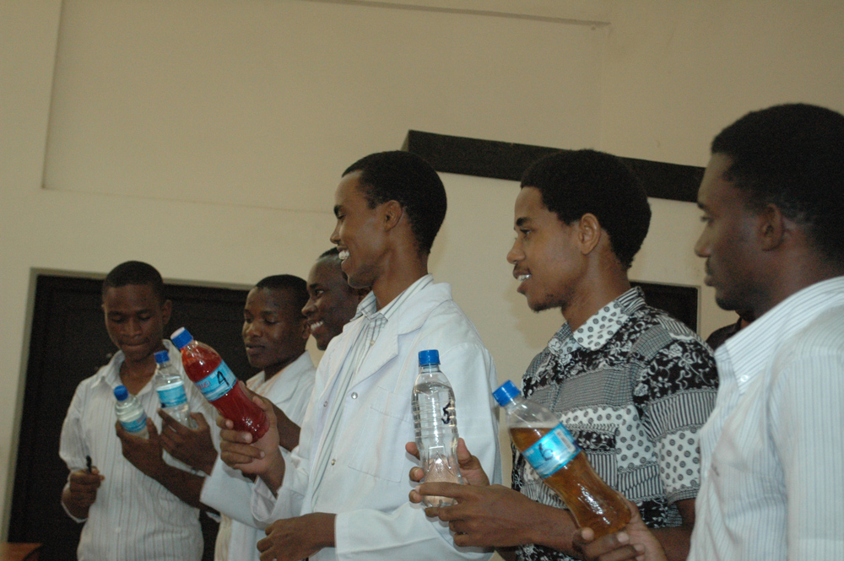

Slide 6
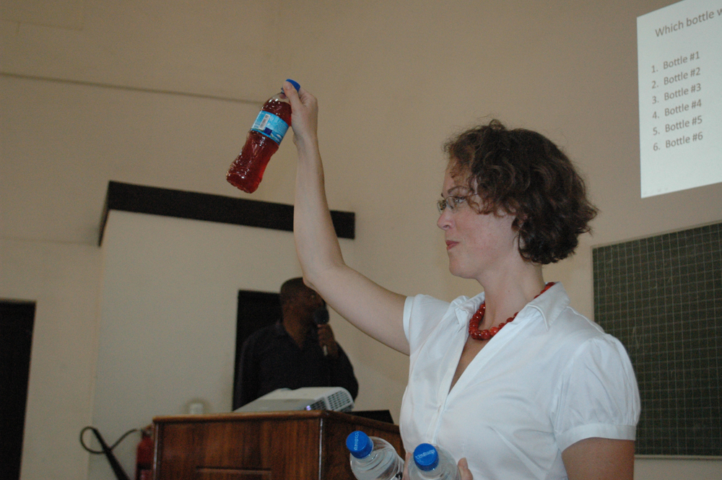

Slide 7
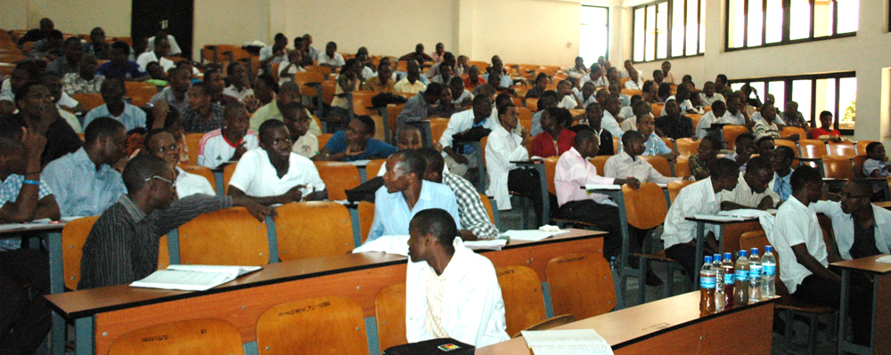

Slide 8
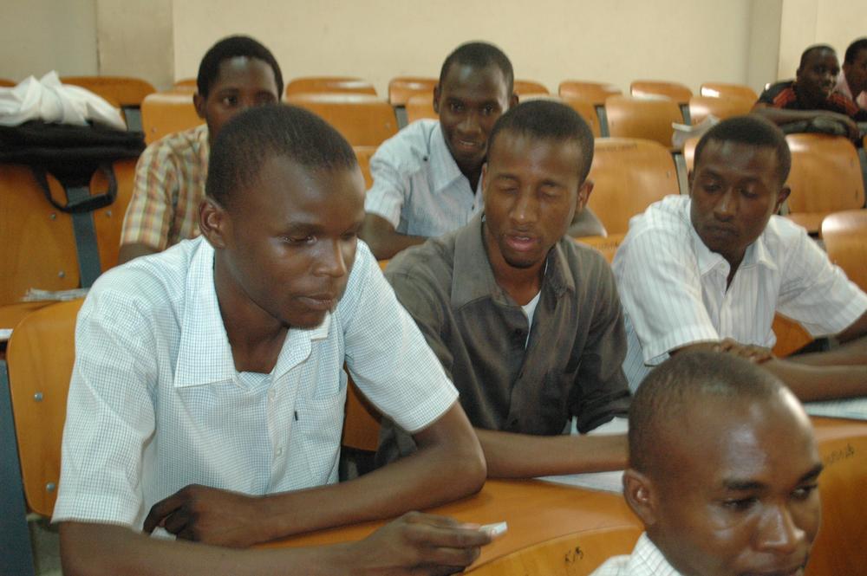

Slide 9
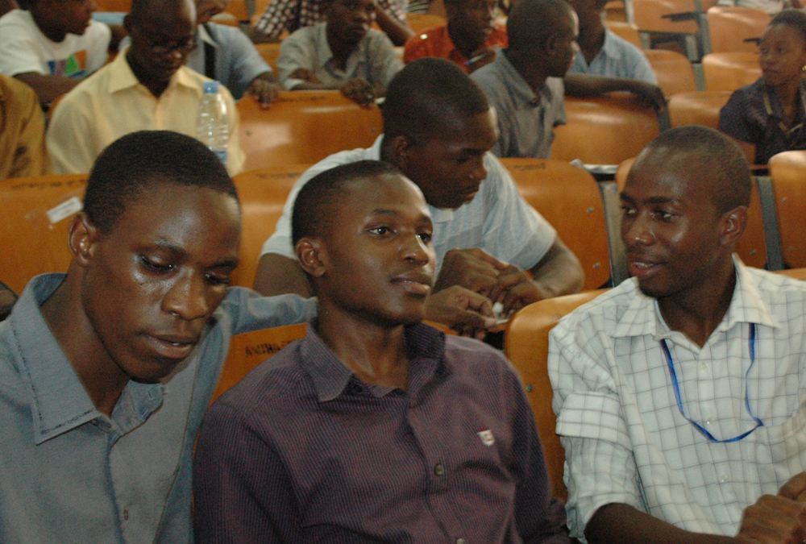

Slide 10
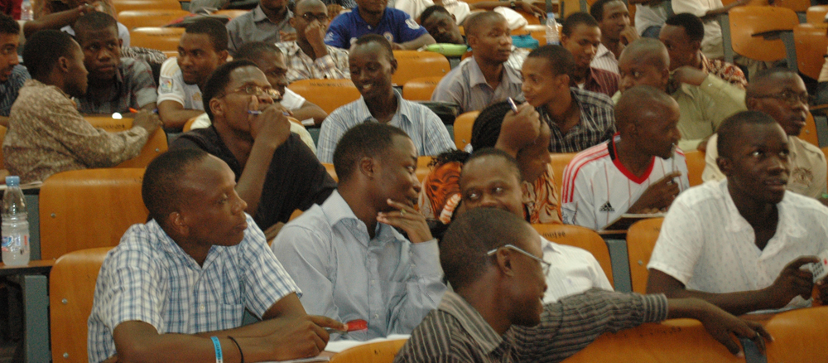

Slide 11
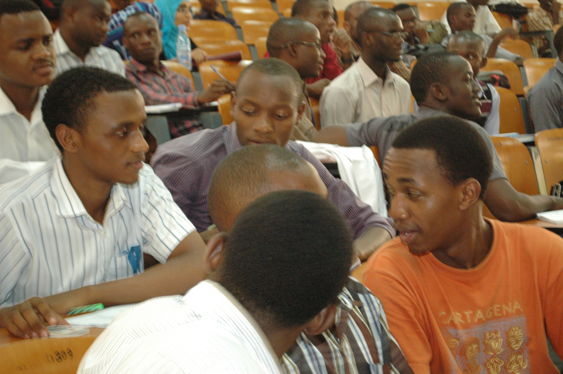

Slide 12
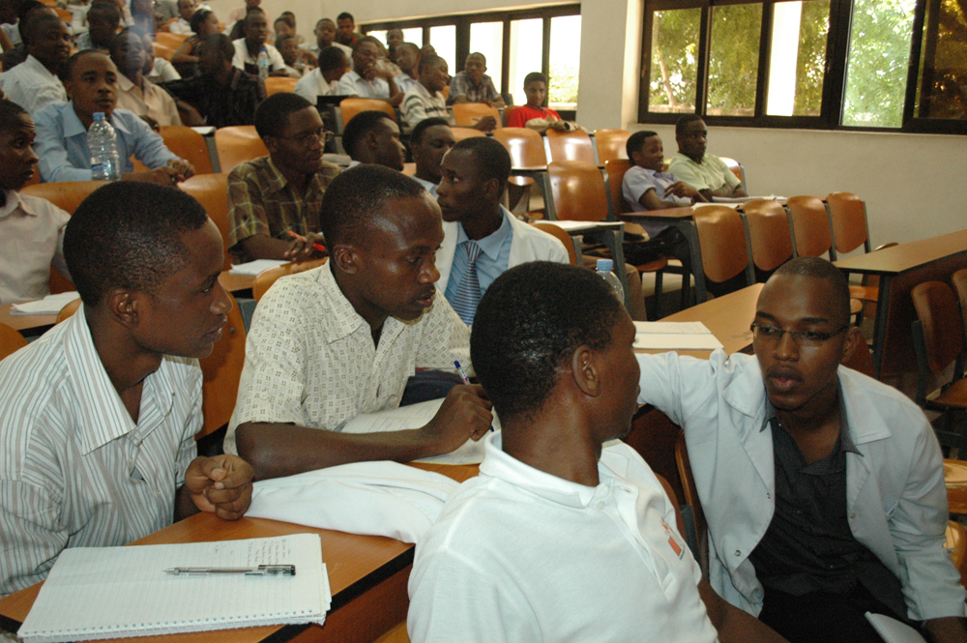

Slide 14
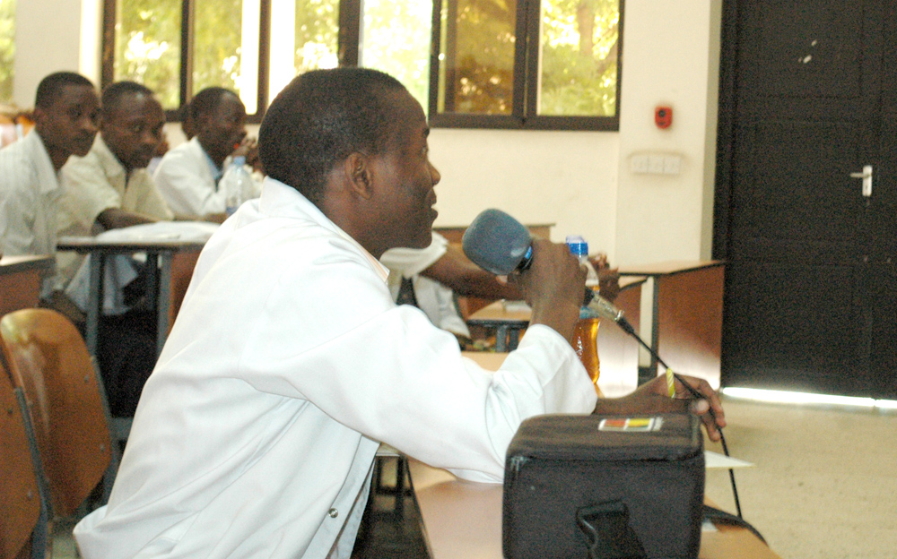

Slide 15
Which water-related disease source do you consider of greatest importance, globally?
Water-borne pathogens
Inadequate water
Water-breeding insect vector
Water-borne toxicant

Slide 16
Which water-related disease source do you consider of greatest importance, globally?
Water-borne pathogens
Inadequate water
Water-breeding insect vector
Water-borne toxicant

Slide 17
“I have disinfected my own drinking water"
Yes
No

Slide 18
What are Clickers
A teacher poses a multiple-choice question to his or her students via a computer projector.
Each student submits an answer to the question using a handheld transmitter (a “clicker”) that beams a radio-frequency signal to a receiver attached to the teacher’s computer.
Software on the teacher’s computer collects the students’ answers and produces a bar chart showing how many students chose each of the answer choices.
The teacher makes “on the fly” instructional choices in response to the bar chart by, for example, leading students in a discussion of the merits of each answer choice or asking students to discuss the question in small groups.

Slide 19
“Putting up your hand in class is pretty complex thing, kind of dangerous, socially and academically. But everyone is willing to give anonymous answers. Everyone is equally involved and the answers are honest. And fast.”

Slide 20
What do we mean by a credit hour?
In class time
Supervised time in and outside of class
Assigned time to a student
70%

Slide 21
Sometimes students will have questions that as an instructor you might not have thought of. And I use them the next day in class by just bouncing them back to the students. Instead of explaining to them what the answer to the question is, I just pose their question [to the class using clickers]. I’ve had some students come to me at the end of the lecture saying, ‘Professor Mazur, that question you asked me, that was exactly the question I had.’ And I look at the student and say, ‘That was your question!’”

Slide 22
Why Use Clickers?
Maintain students’ attention during a lecture.
Promote active student engagement during a lecture..
Promote discussion and collaboration among students during class
Encourage participation from each and every student in a class
Create a safe space for shy and unsure students to participate in class.
Enables students to respond anonymously to sensitive ethical, legal, and moral questions.
Check for student understanding during class.
Teach in a way that adapts to the immediate learning needs of his or her students

